Slide 1
Data Visualisation and Storytelling
1.1: Introduction to R
Jacob Curran-Sebastian

Slide 2
Course Materials
All course materials are available on the course website:
https://ku-dviz.github.io/2024/
You can also find the materials on the course github for the practical session:
https://github.com/ku-dviz/2024

Slide 3
Looking ahead
Day 1:
Introduction to R and plotting using ggplot2
Fundamentals of Data Visualisation (part 1)
Day 2:
Fundamentals of Data Visualisation (part 2)
Plotting with Maps

Slide 4
Looking ahead
Day 3:
Introduction to Principal Component Analysis and Dimensionality Reduction
Plotting with Networks and Directed Acyclic Graphs in R
Day 4:
Interactive plots for presentations and websites
Plotting using shiny, interactive maps, Sankey plots
Plenary

Slide 5
Before we start:
You do not need to be writing code along with the slides, but if you already have R installed, you might find it helpful.
We have designed this course with tips for making visualisations in R, but if you use e.g. Python, you are perfectly free to follow along using your preferred language.
Please do give us feedback either as we go along, or in the evaluations.

Slide 6


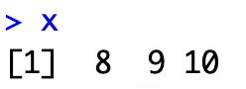
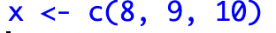
R basics
Create a variable in R by using an arrow <-, e.g.
The nice thing about this is that we can do bidirectional assignment, e.g.
We can also create vectors of numbers by concatenation, using the c() function in R:

Slide 7
Data Types in R
Type | Explanation | Examples
numeric | A single floating point value, or a vector of floating point values. | 10, pi, c(1, 2, 3), rep(5, 10)
integer | A single integer, or vector of integers. | 10L, as.integer(pi), rep(5L, 10) (L denotes an integer)
character | A string or literal – often used for storing categorical variables | “10”, ”height”, “TRUE”, “as.integer(pi)”
logical | A boolean, i.e. a TRUE or FALSE, useful for if/else statements | TRUE, FALSE, as.logical(1), as.logical(110), as.logical(0)
data.frame | A table in which data is stored, with column variables and row variables | data.frame(Numbers = 1:10)
matrix | A table in which data can also be stored, not necessarily named | matrix(1:9, nrow = 3)
You can check the class of any object by running class( your_object )

Slide 8
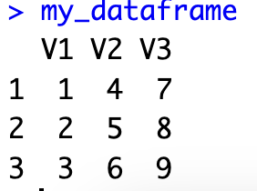
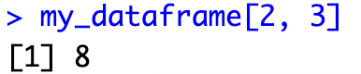

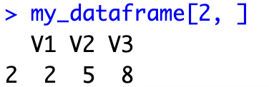

Dataframes
Dataframes are a kind of table in R that is used for storing data.
You can think of the rows and columns of a dataframe as being vectors, which can be extracted.
You can access the entries of a dataframe by using sqare brackets – e.g. if I want the entry from the second row and the third column, I can write:
For the whole second row, I can leave a space where the column is specified, e.g.

Slide 9
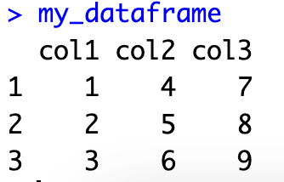
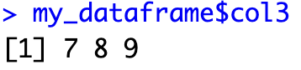

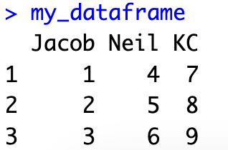
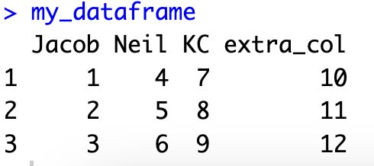
Dataframes
Typically, dataframes will have named variables.
An easier way to extract named columns is using the $ sign, e.g.
You can change the columnames by assigning a new vector to the dataframe, using the function colnames:
You can also add columns using the dollar sign:

Slide 10
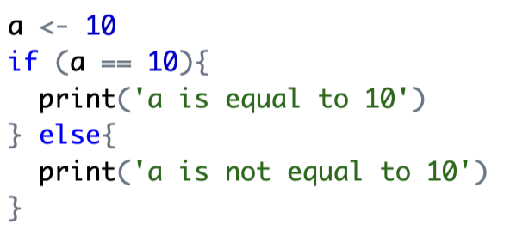
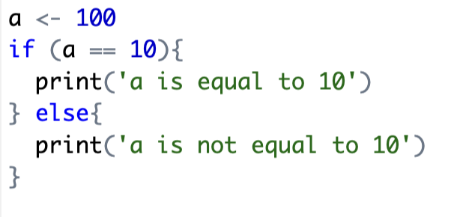
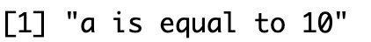
If/Else statements
We can specify that a block of code should be run only if a given statement is TRUE. E.g.
Note that we need a double equals (==) sign!

Slide 11
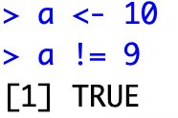
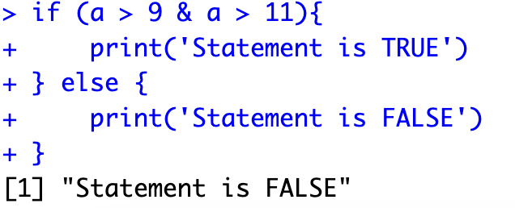
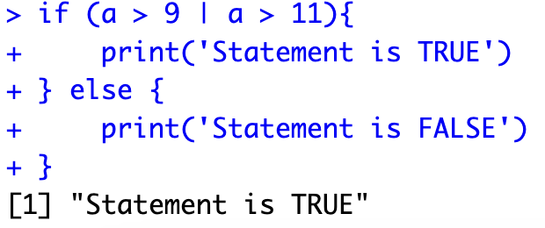
If/Else statement
Additional operators: != (not equal), <, >, <=, >=
We can also combine logical statements with the & (AND) and | (OR) operators.

Slide 12
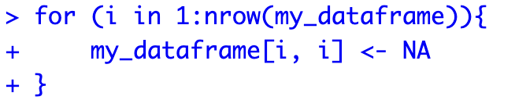
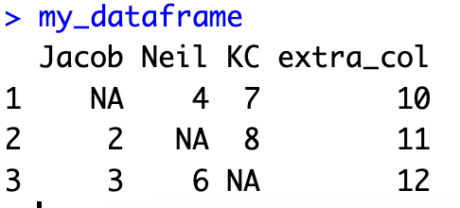
For Loops
We may also occasionally wish to loop over all observations in a dataset.
The function nrow() counts the number of rows in my dataframe, and we then execute the commands in the for loop with different values of i (in this case, i=1, 2, 3)

Slide 13
Packages
In this course, we will be using a few packages.
In R, most packages that are used widely are located on the CRAN (Comprehensive R Archive Network).
These packages can be installed (if they are not already) using the command install.packages(‘package_name’)
For now, we will be using the packages dplyr and ggplot2, try installing these yourself now in R.
At the start of an R script, load the libraries that you are using by writing e.g. library(dplyr).

Slide 14
Dplyr – a useful package for data manipulation
Good data visualisation starts with clean data, and dplyr is the main package in R for cleaning data.
As we will see, the main package in R for creating plots works very well with dplyr.
Let’s see a few examples of dplyr in action - we’re going to use a preloaded dataset, which contains information about different characters from Star Wars.

Slide 15
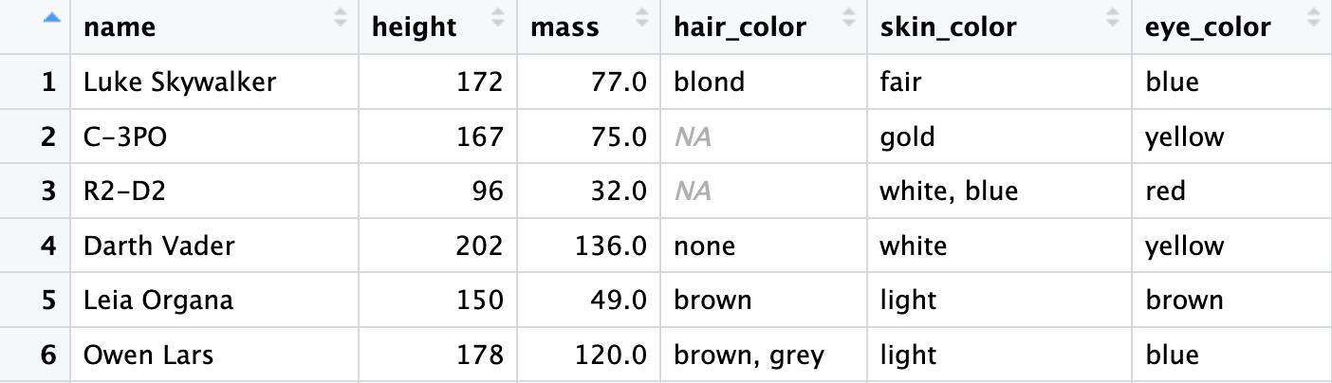
Dplyr – a useful package for data manipulation

Slide 16
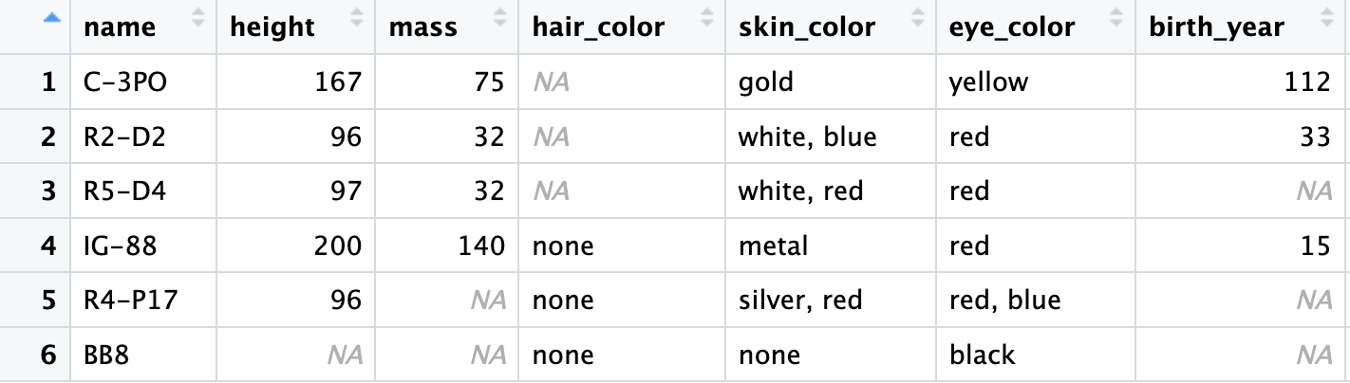
Dplyr – a useful package for data manipulation
starwars

Slide 17
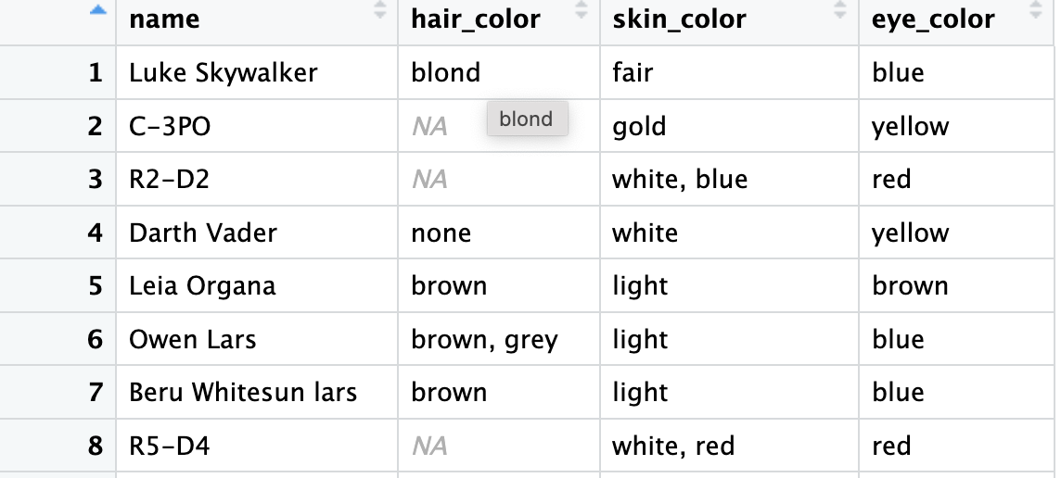
Dplyr – a useful package for data manipulation
starwars

Slide 18
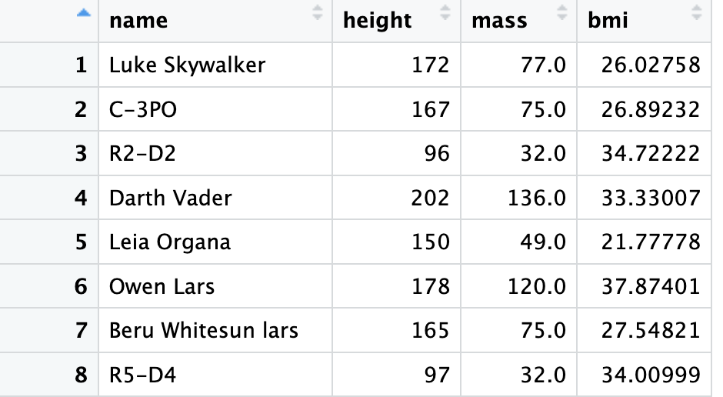
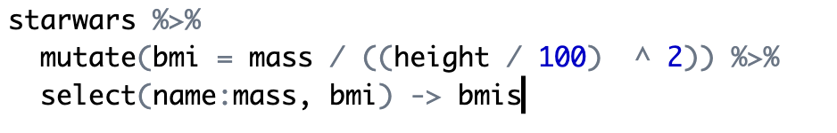
Dplyr – a useful package for data manipulation
starwars

Slide 19
Making Plots in R using ggplot2

Slide 20
Plotting with ggplot2
ggplot2 is a powerful visualisation tool works well with data that has been formatted using dplyr.
Plots in ggplot2 are built by calling the function ggplot, together with a dataset and an aesthetic mapping (denoted aes).
This mapping can describe, for example, the variables on the x and y axis, or the colour mapping for different values within a dataset.

Slide 21
Plotting with ggplot2
Once you’ve created a ggplot object, other aspects of the plot can be added on in layers.
Let’s look at an example, using the starwars set from earlier.

Slide 22
Plotting with ggplot2
Suppose I want to study the BMI of different characters from Star Wars.
Let’s use ggplot to make a histogram of the BMIs of different Star Wars characters.

Slide 23
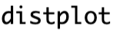
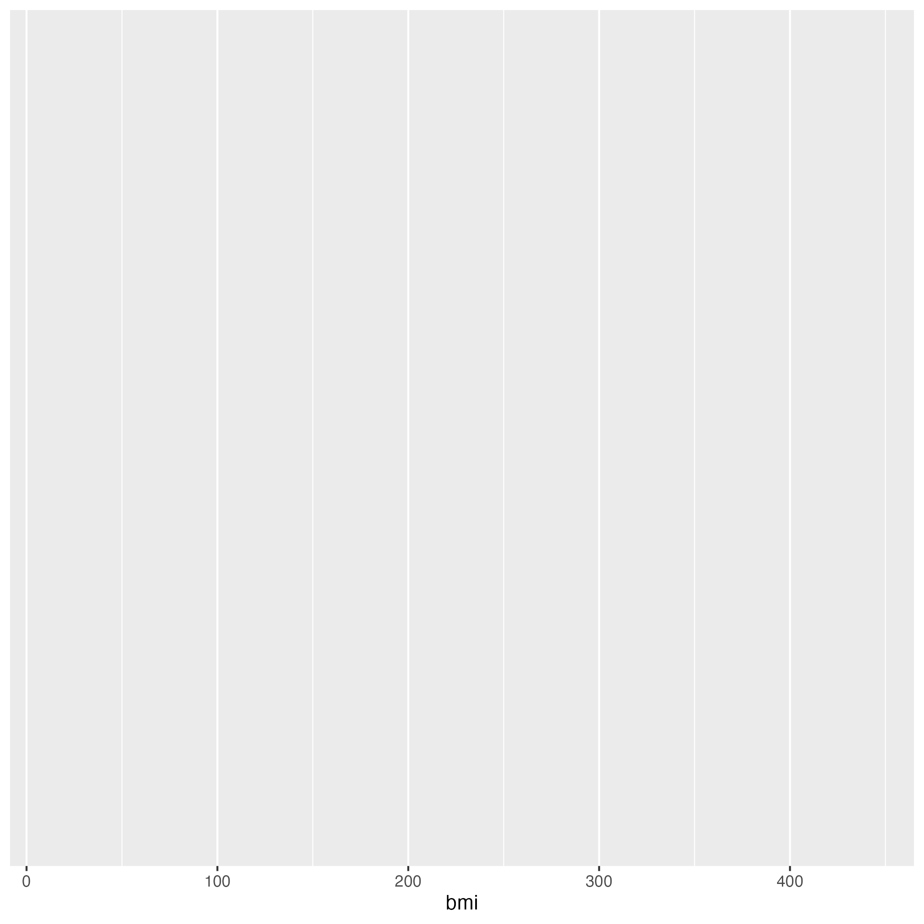
Plotting with ggplot2

Slide 24
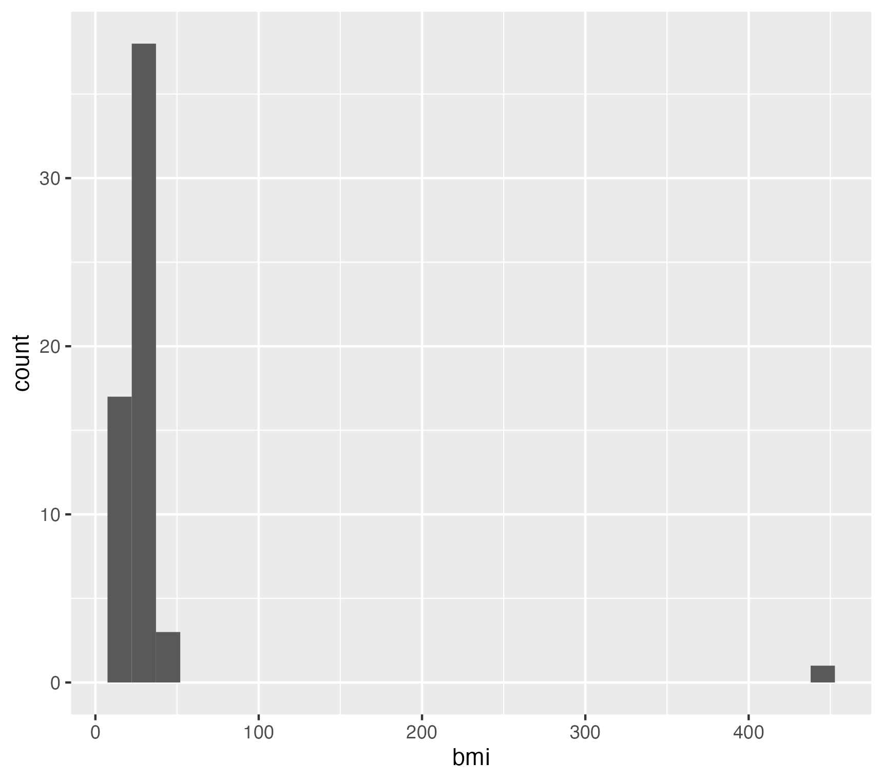
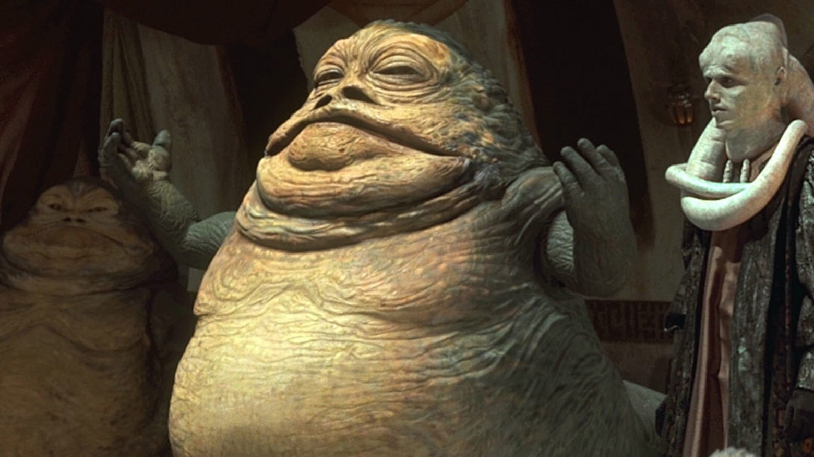
Plotting with ggplot2
Add elements with a + sign

Slide 25
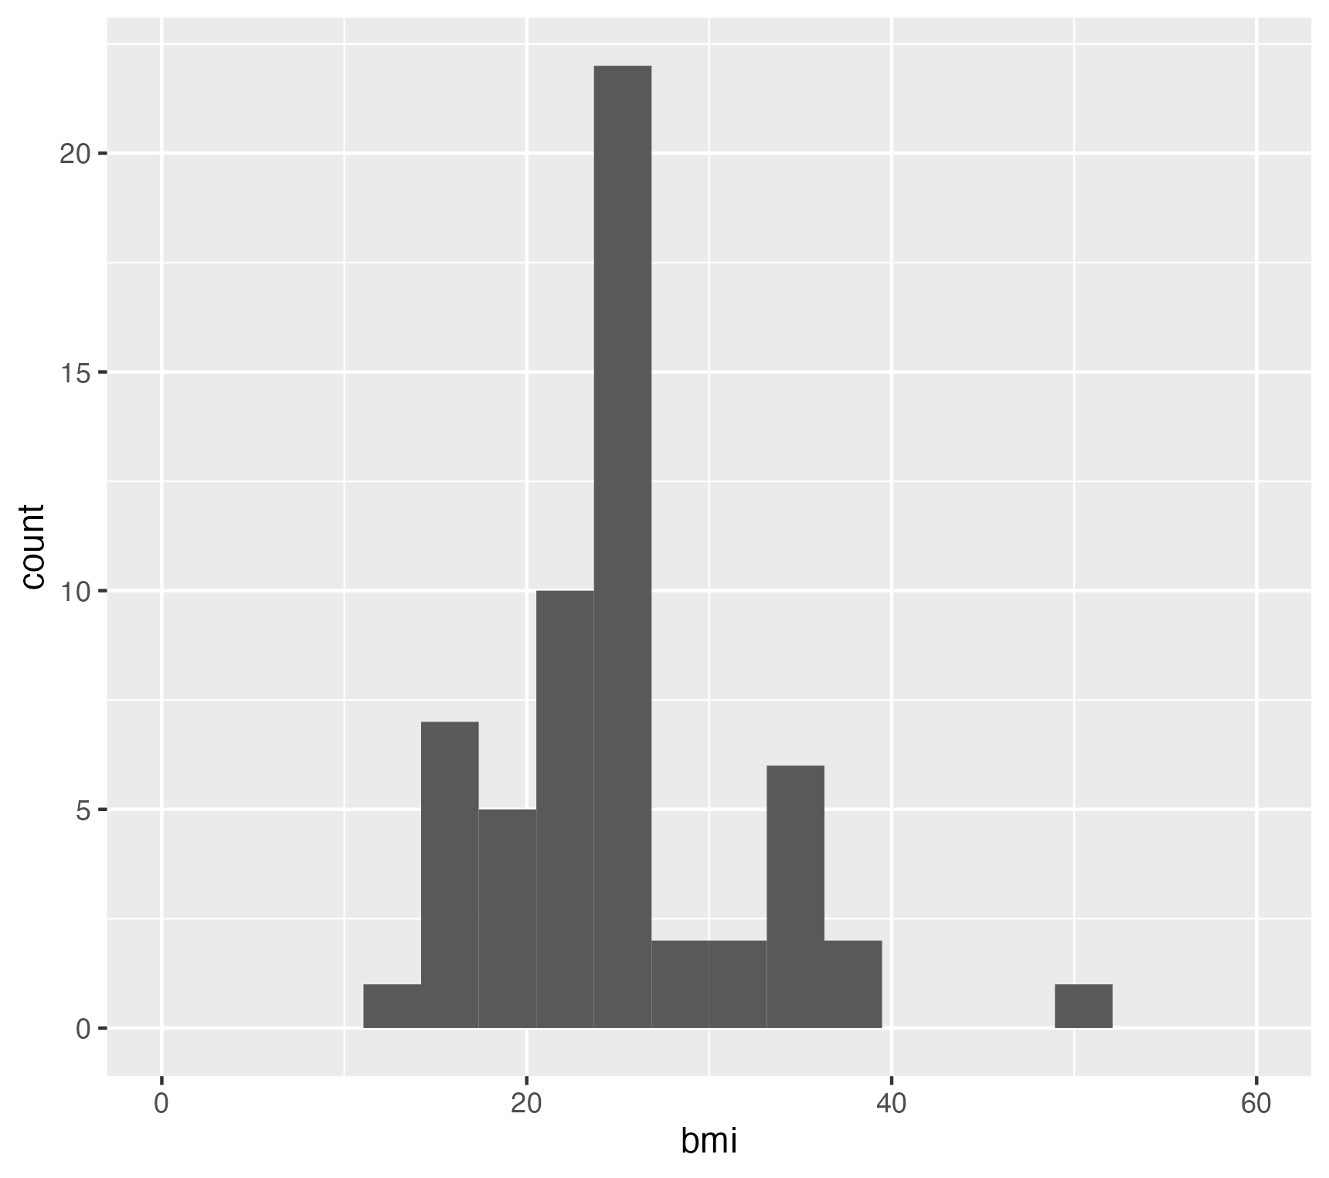
Plotting with ggplot2
Still pretty ugly ☹

Slide 26
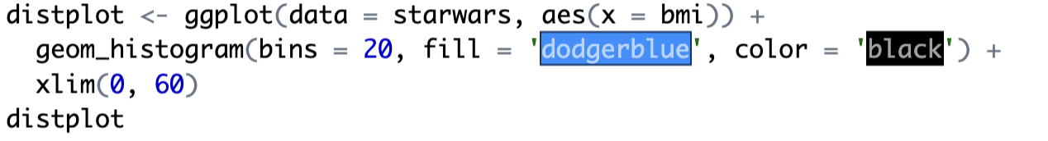
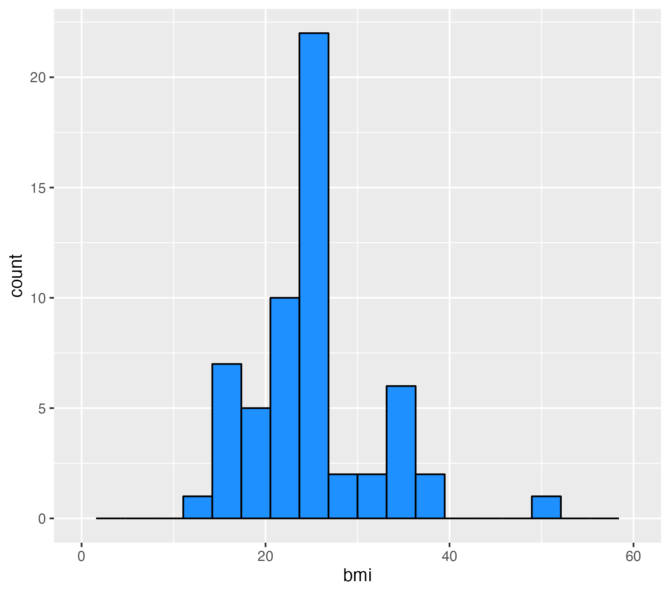
Plotting with ggplot2
Now we add a splash of color – we can choose any colour from the R colour palette.
This looks much better, but there’s still a few things we can add to finish it off.

Slide 27
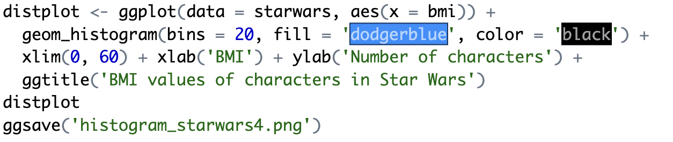
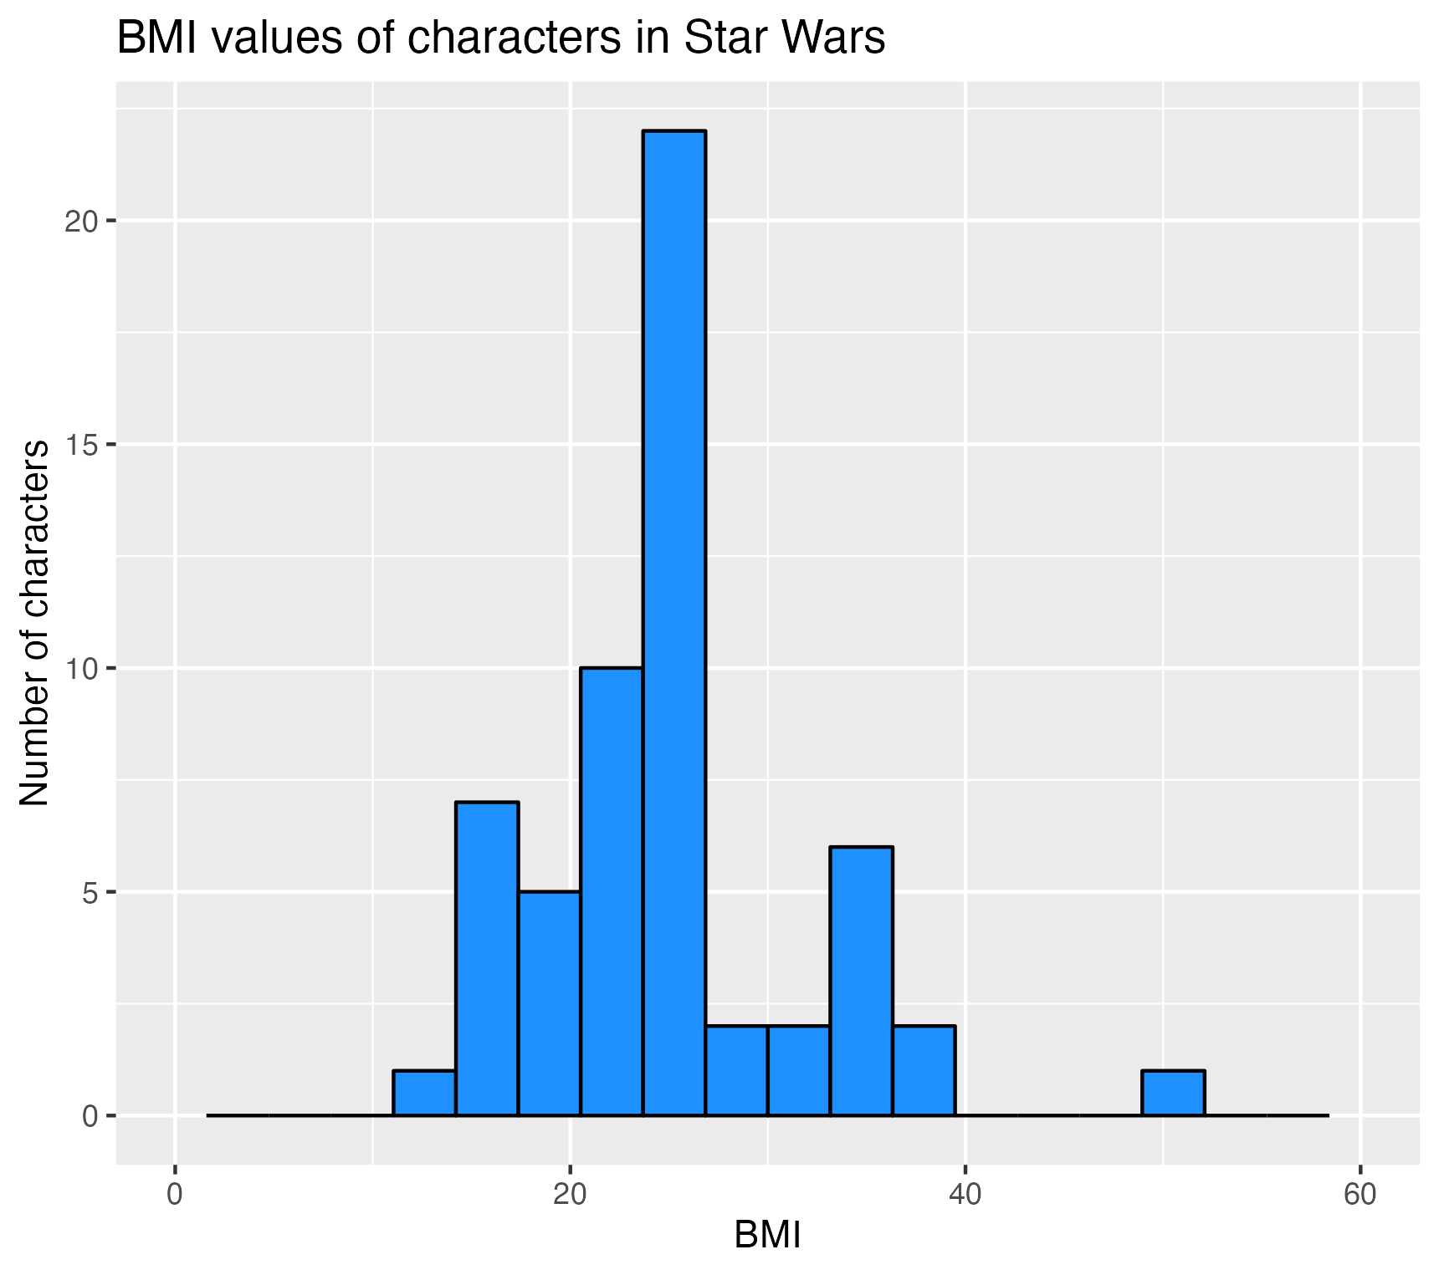
Plotting with ggplot2
We add in a title and labels for the axes
Finally our plot is good enough to save!

Slide 28
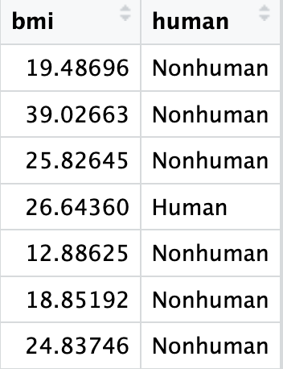
A bit more advanced
Suppose now we want to compare BMIs of different groups of characters, for example, humans and nonhumans.
First, we create a separate column that says whether a character is human or nonhuman:
Then, we drop all those characters who have an NA value for their BMI:

Slide 29
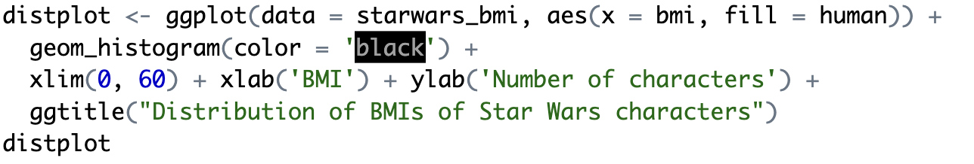
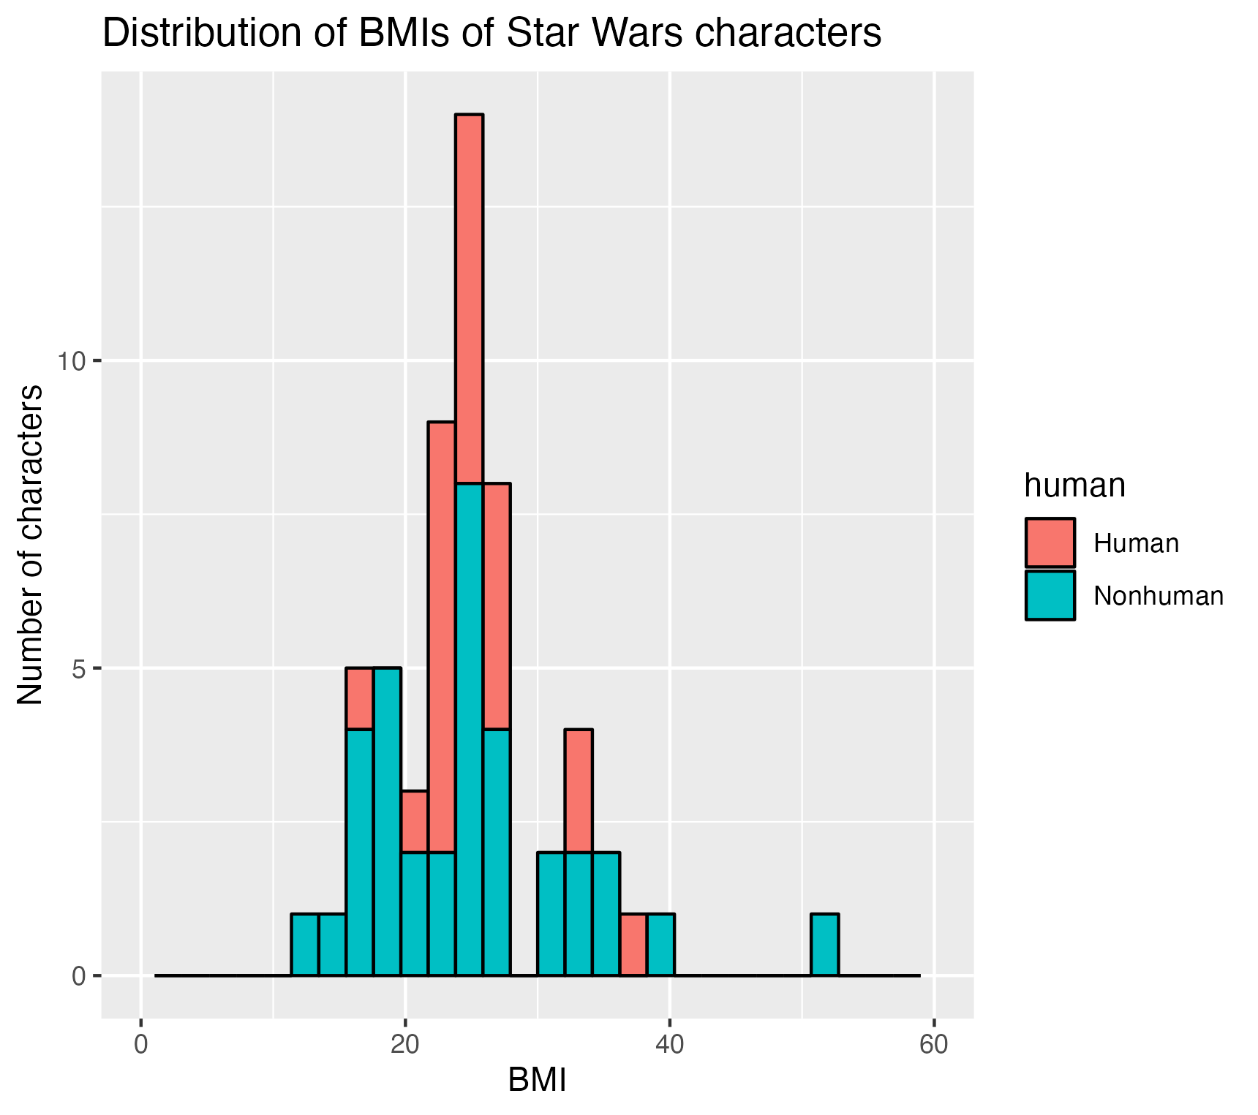
Plotting with ggplot2
Let’s produce the same histogram plot as before, but this time with the different types of characters separately.
Looks ok, but because the bars are stacked on top of each other, it can be quite hard to compare the distributions.

Slide 30
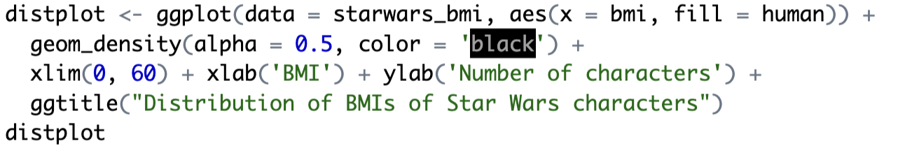
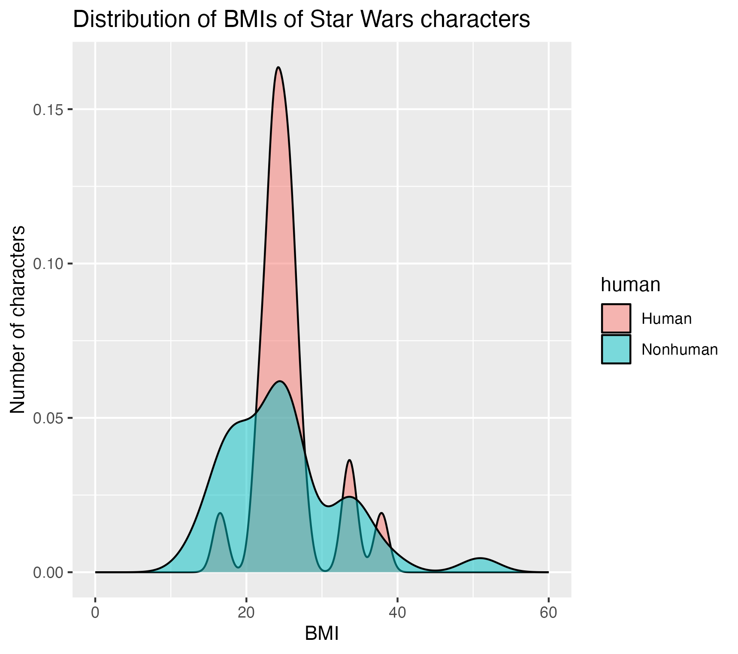
Plotting with ggplot2
Instead, lets try a density plot:
This looks a bit nicer – and setting alpha = 0.5 means you can see where the two distributions overlap.

Slide 31
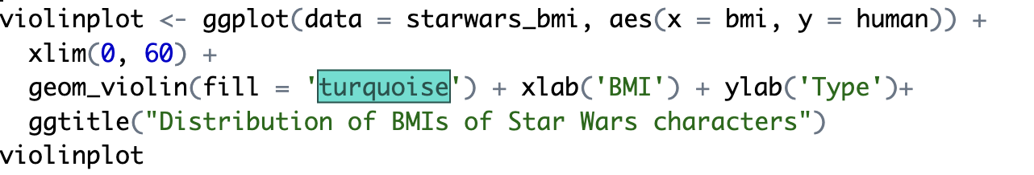
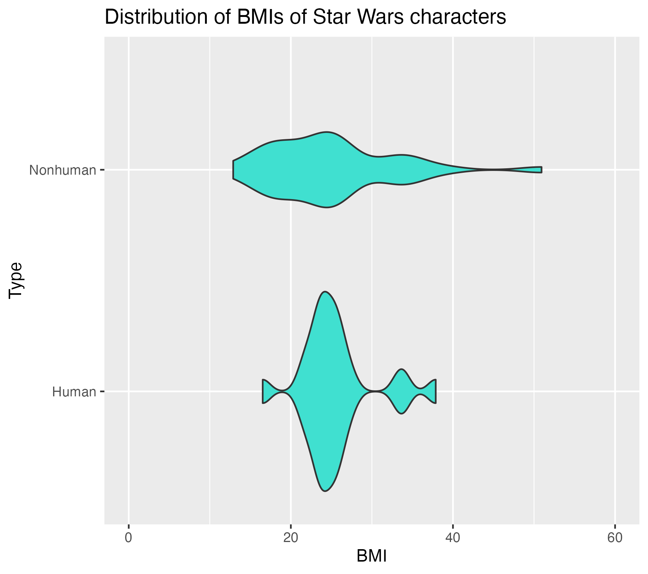
Plotting with ggplot2
There are other kinds of plots we could try, we could separate out the distributions for each type using a violin plot
But I personally think the density plot looks nicer, at least when we have just 2 distributions to compare.

Slide 32
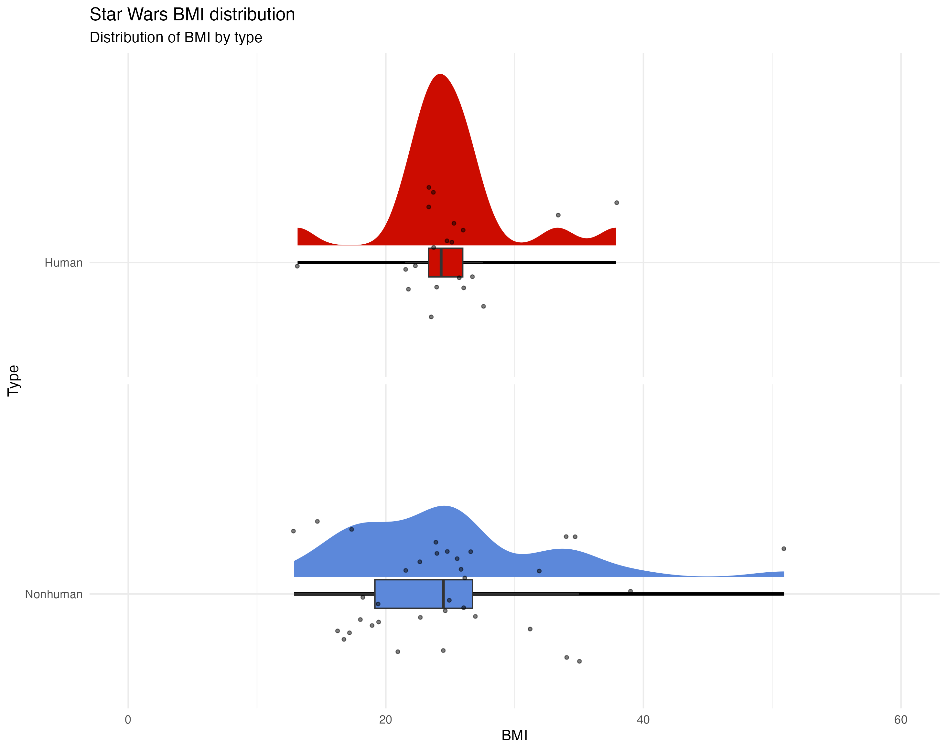
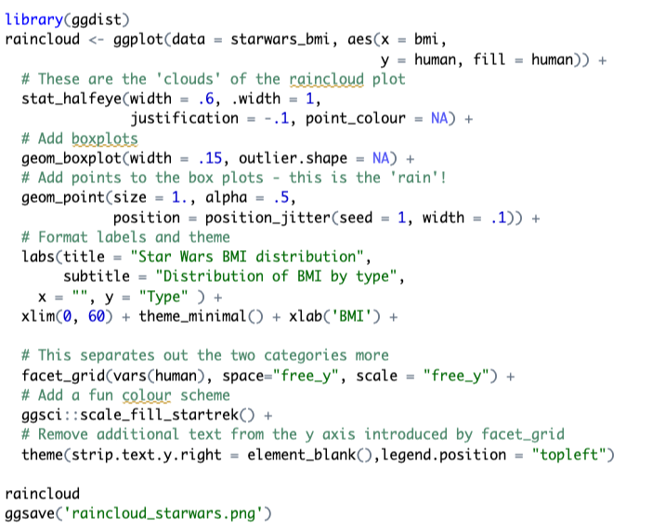
Plotting with ggplot2
If we want to be even fancier, we could try something like a raincloud plot.

Slide 33
Making line plots
There are a whole bunch of other kinds of plots that you can use ggplot to make (and we’ll cover many in this course!)
Let’s take a look at how to make a line plot.
These are useful for plotting time-series data – let’s try making a simple line plot to look at the number of cases of COVID-19 over time in Denmark.

Slide 34
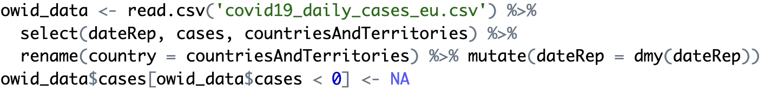
Loading Data
Now we are working with a real dataset – we can load in the data using R’s read.csv function
This gives us a dataframe with a lot of rows and columns, but we only want some of them – we can select exactly what we need using dplyr:

Slide 35
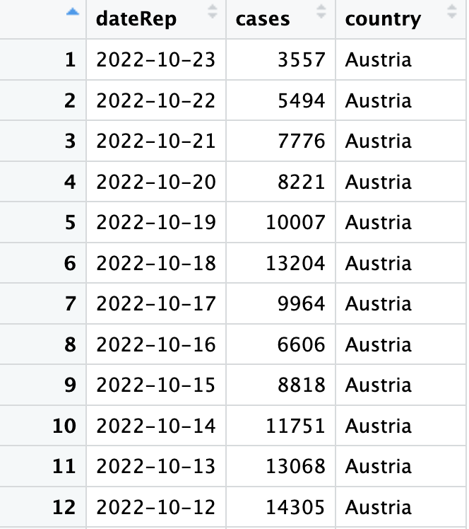
Making line plots
This gives us a nice looking dataframe that we can work with. Now let’s just select the data that we need for Denmark.
Now we can plot this data – this will be similar to the histogram, but now we use geom_line() to get a line plot.

Slide 36
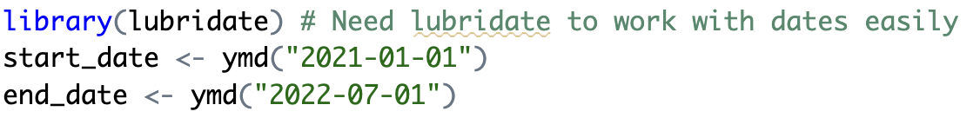
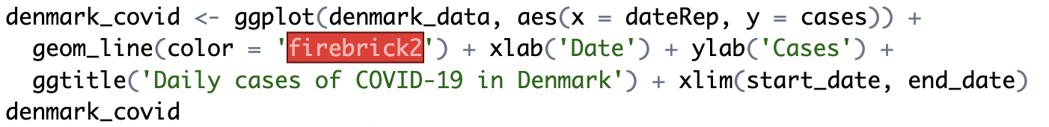
Making line plots
Let’s first look at data starting from 2021, so we set a start and end date.
Now we create our plot in ggplot:

Slide 37
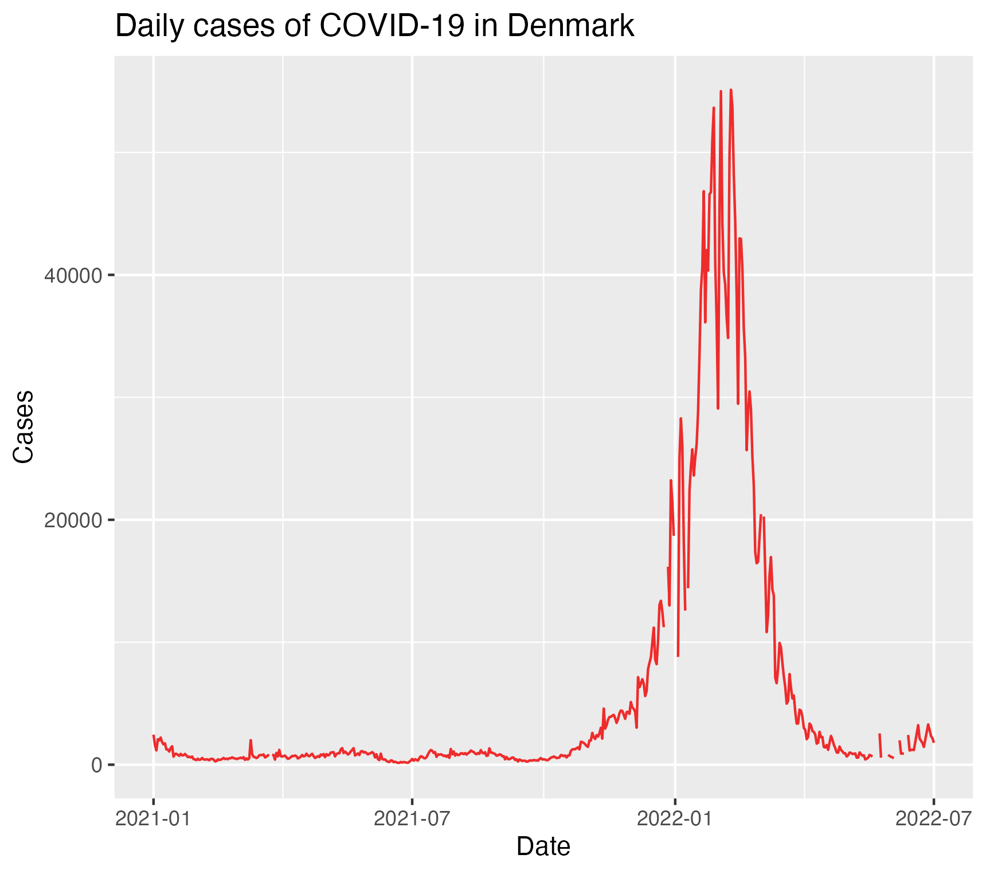
Making line plots

Slide 38
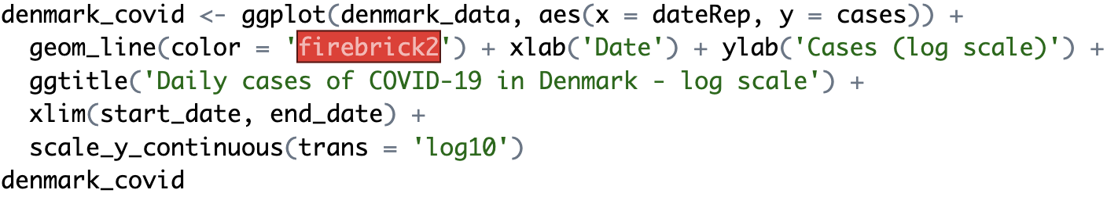
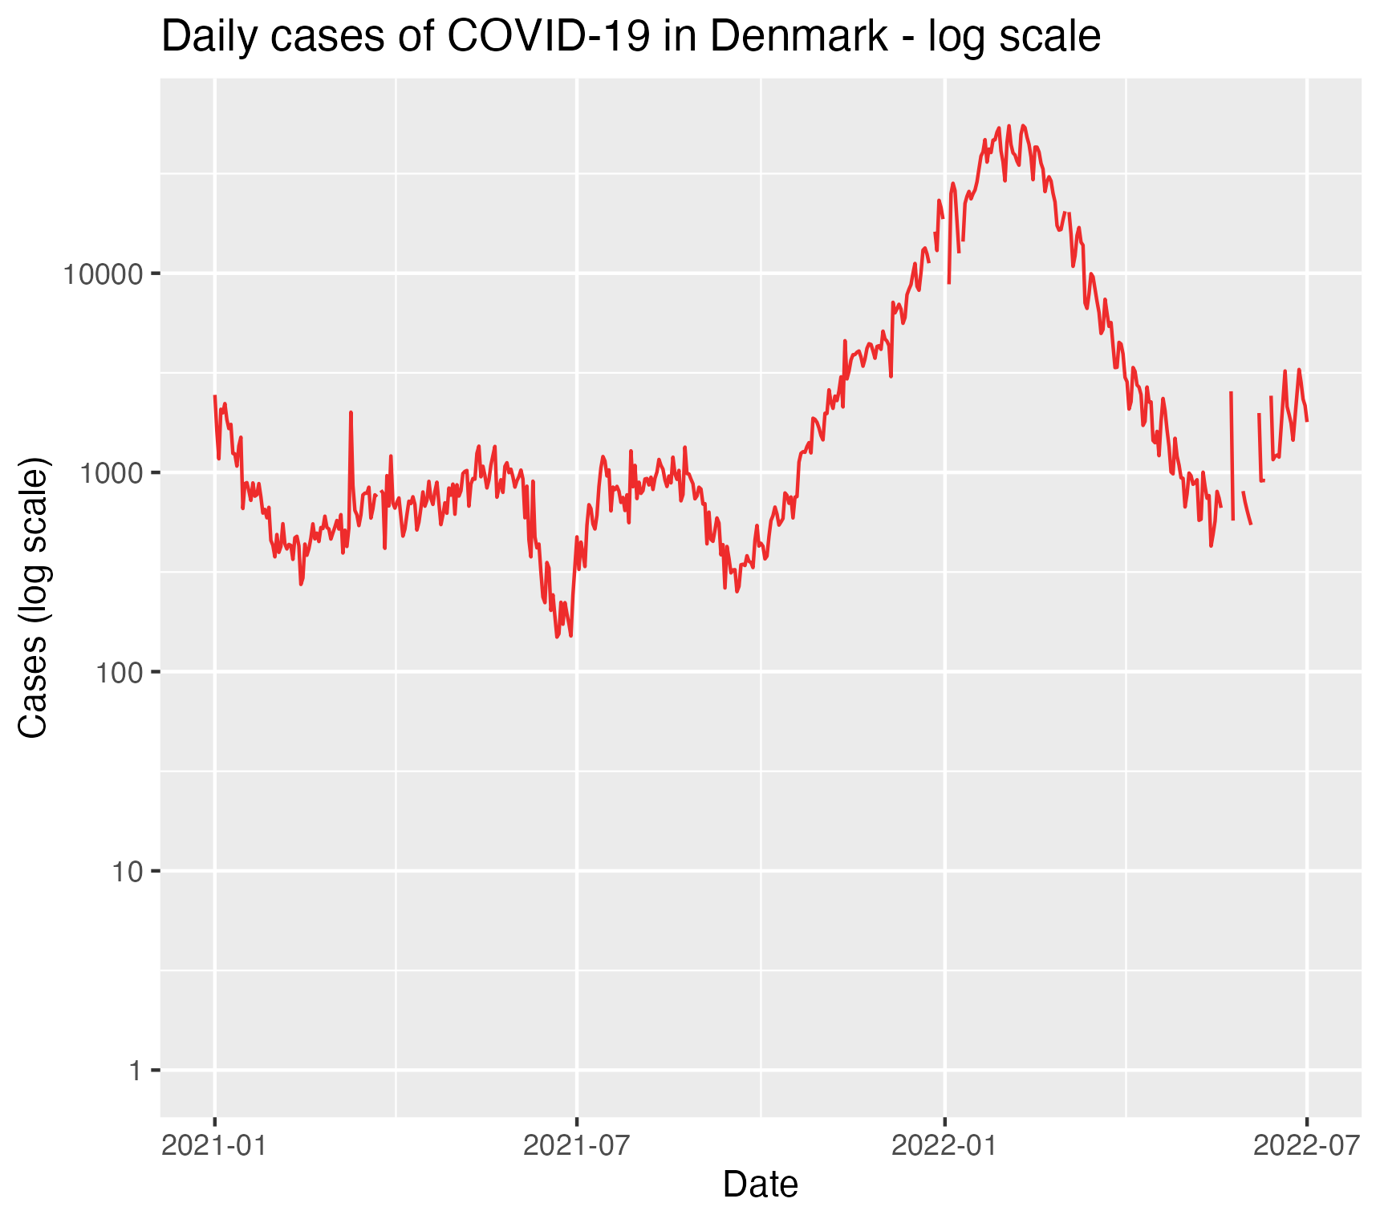
Making line plots
Minor point – because this is disease data, and growth is exponential, we could also choose to plot this on a log scale!

Slide 39
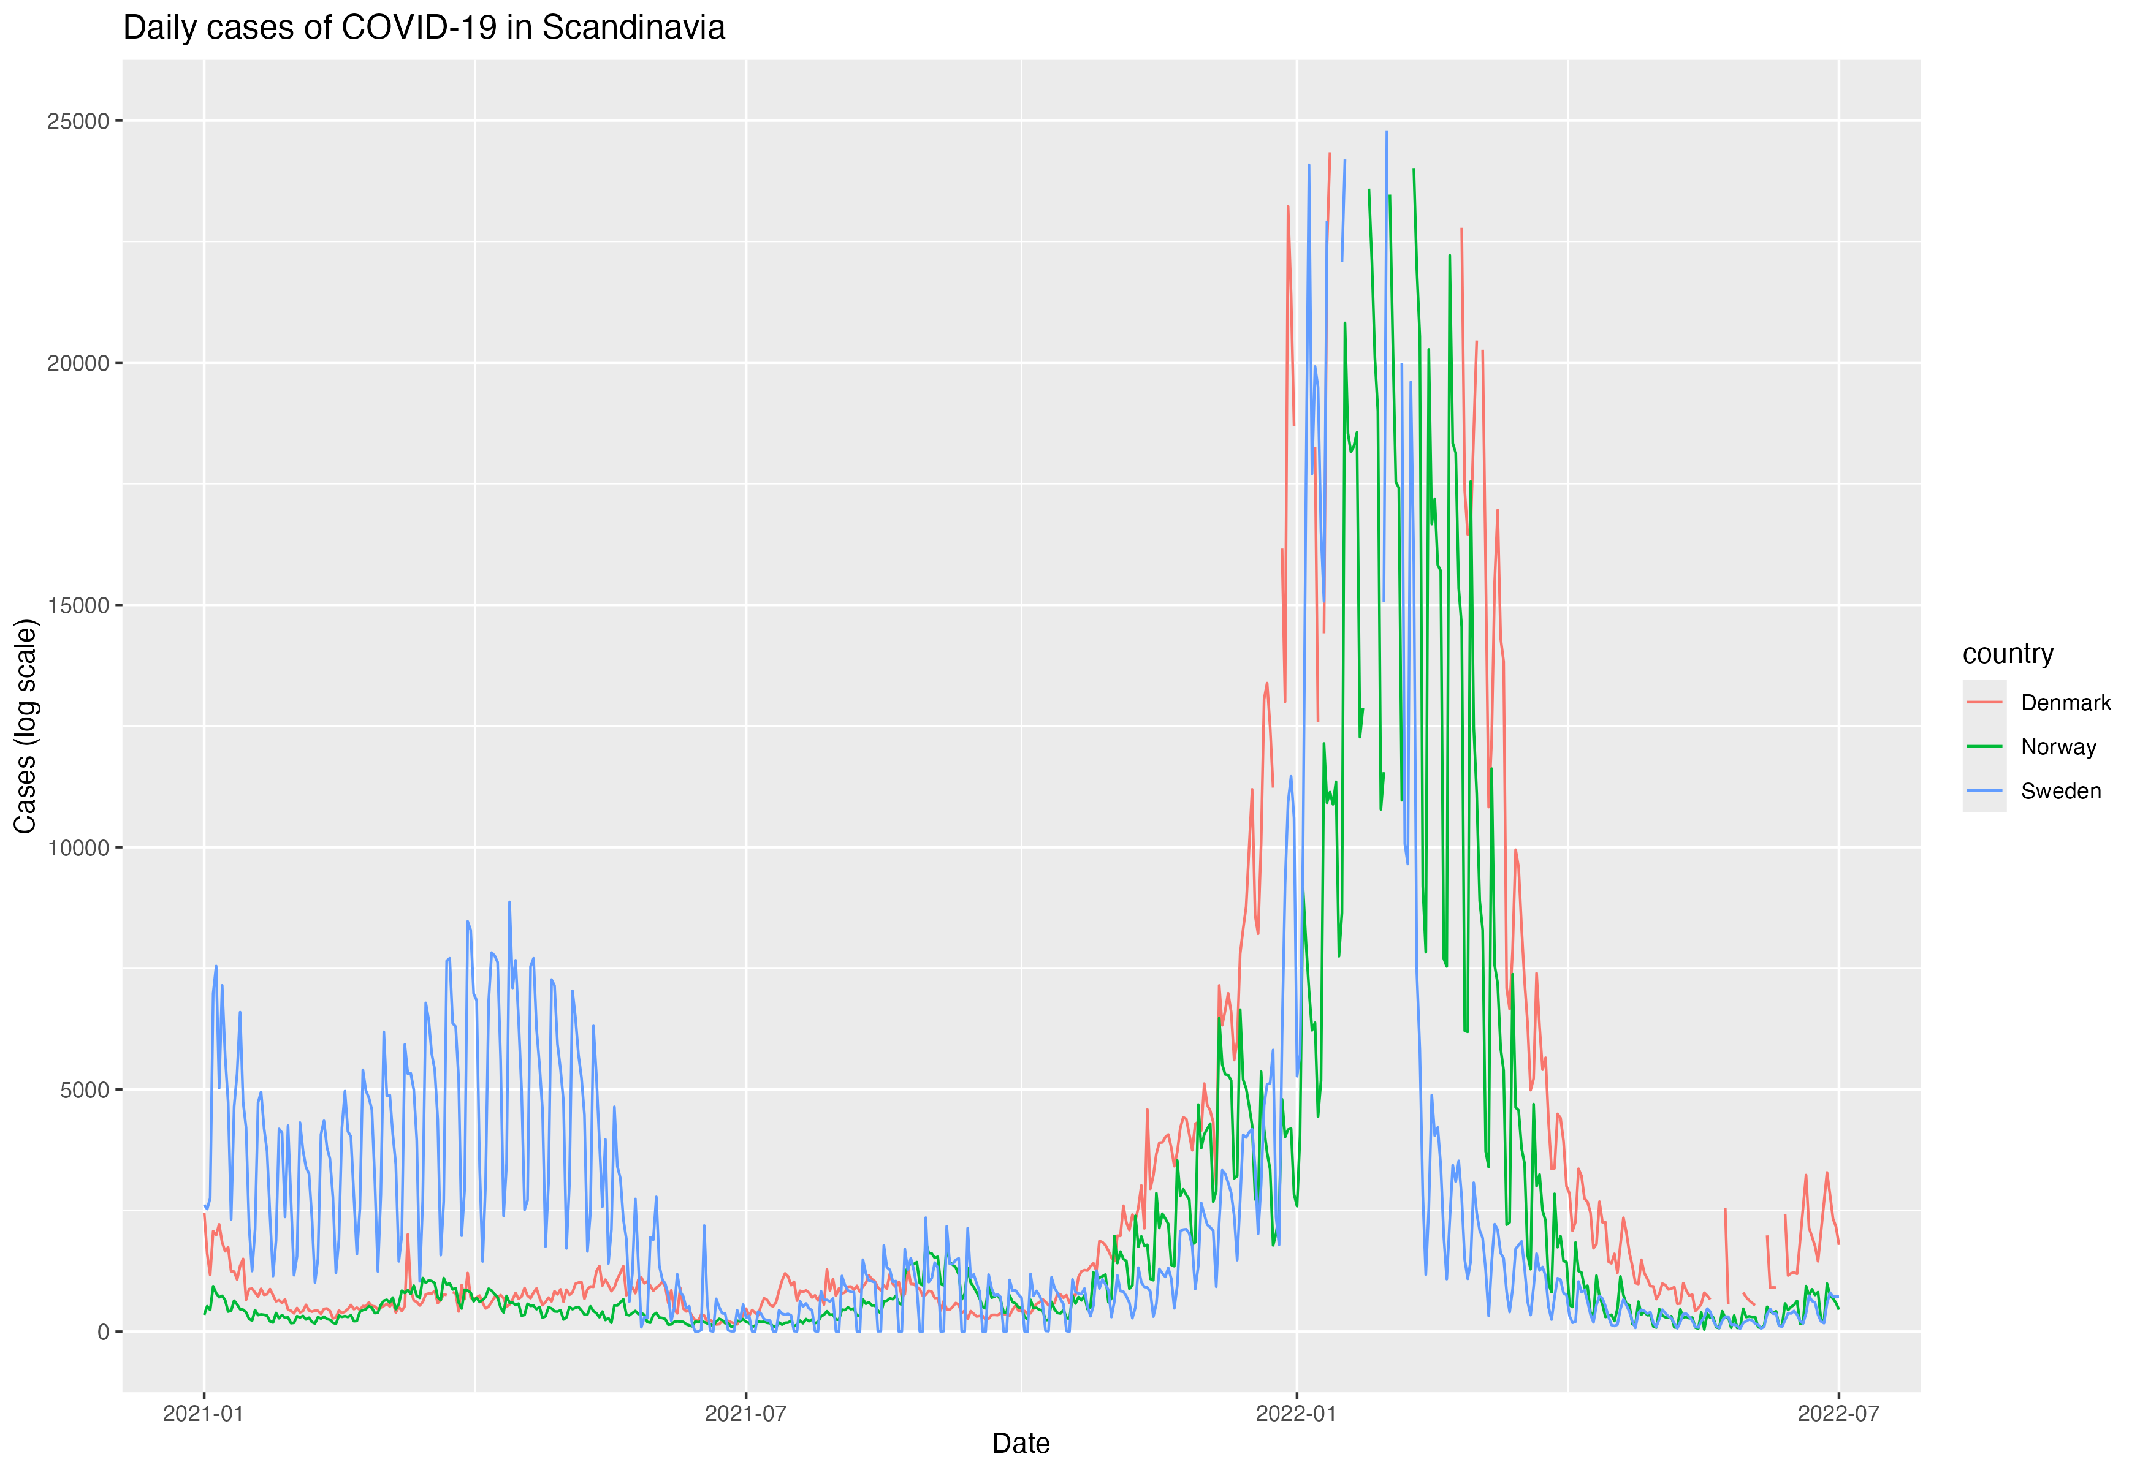
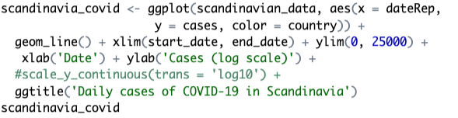
Making line plots
Finally, we can plot several lines at once, e.g., we can take some other Nordic countries and compare the daily cases:
To create the plot:

Slide 40
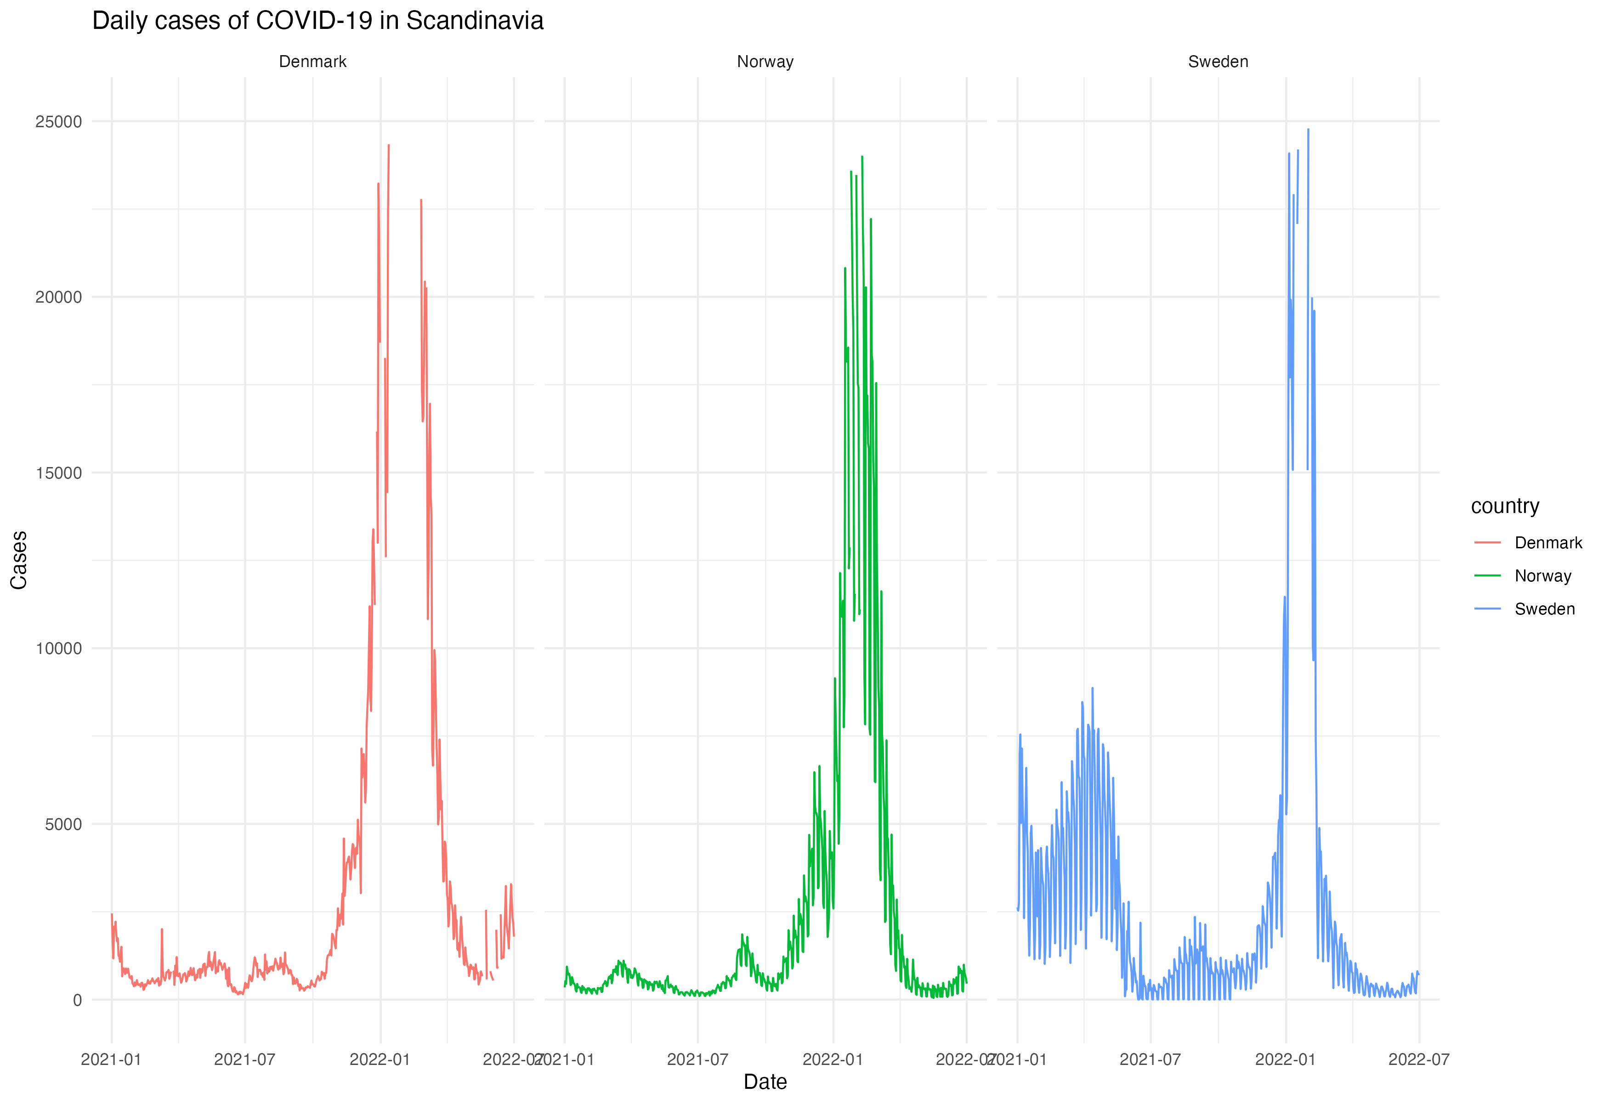

Making line plots
We can also plot cases side by side for easier comparison, using a facet_grid():

Slide 41



Heatmaps
We will also be making use of heatmaps:
Here we can investigate associations between categorical variables:

Slide 42


Heatmaps
This gives us the raw number of diamonds in each category, but we may wish to scale the colours to show the proportion within each group:

Slide 43


Heatmaps
This gives us the raw number of diamonds in each category, but we may wish to scale the colours to show the proportion within each group:

Slide 44
Other kinds of plots
Plots in ggplot2 are usually prefixed with geom_ (we’ve already seen e.g. geom_tile, geom_histogram, geom_density)
https://ggplot2.tidyverse.org/reference/index.html consult the reference page for a full list of different geoms that you can use and have a play around in the practice session when we get to working with real datasets.
There is also a nice website here https://www.data-to-viz.com that showcases many different types of plot in ggplot2.

